Slide 1
Advanced Proramming with Java
Prativa Nyaupane

Slide 2
Recap
Variables and Data Types
Conditional Statements

Slide 3
Today’s Objectives
Access Modifiers
Exception Handling
Java Collections
Review of object oriented principles
Super class, sub class, inheritance and member access

Slide 4
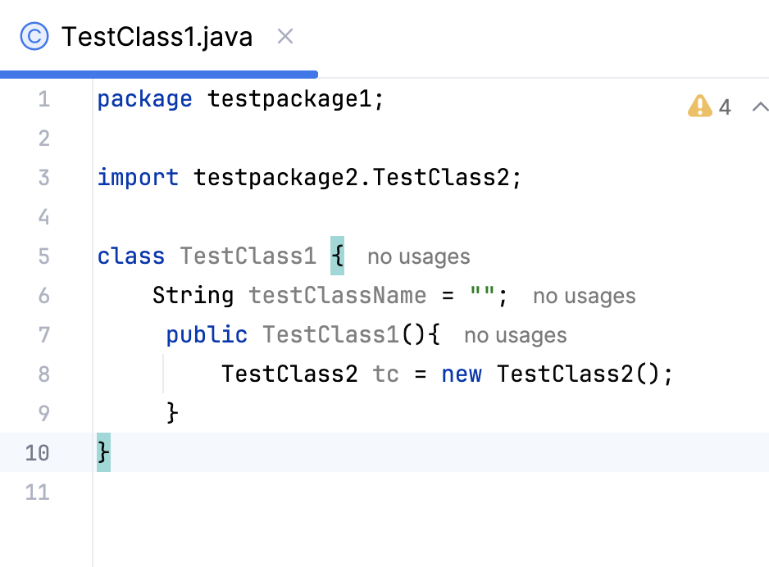
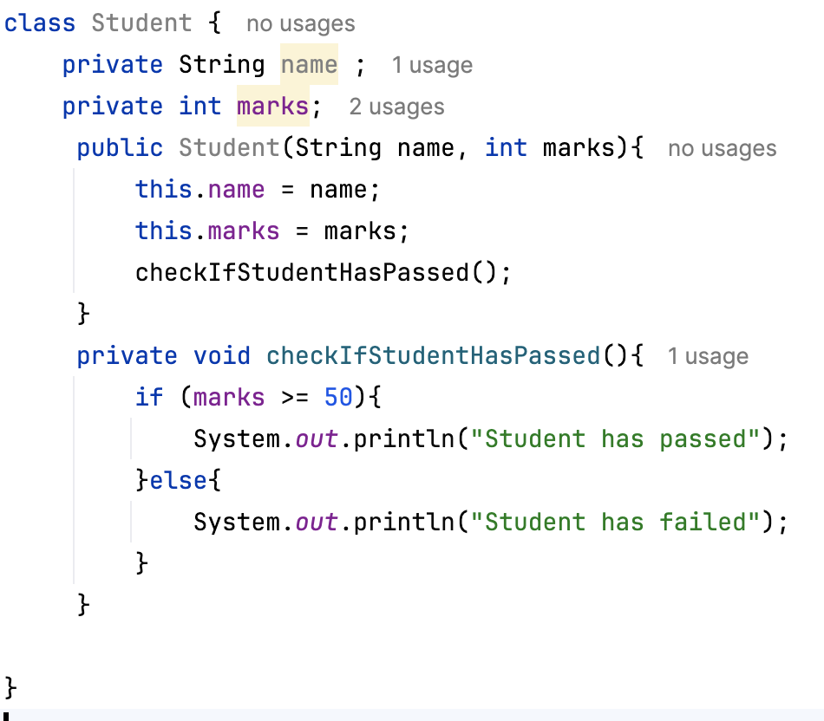
Access Modifiers
Java provides access modifiers to control the visibility and accessibility of classes, variables, methods and fields.
Provides security, accessibility to the user depending upon the access modifier used with the element.
Four types of access modifiers are:
Default:
When no access modifier is specified, then the class, data members or methods have default constructor.
It restricts access to the same package
Private:
It is specified using the keyword “private”.
Any other class of the same package will not be able to access these members
Fig: Default Access Modifier

Slide 5
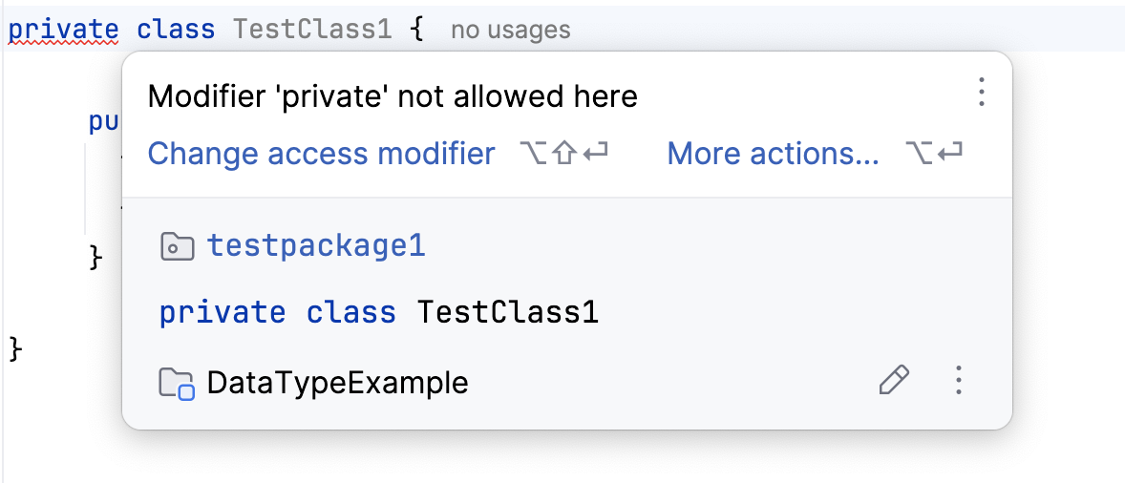
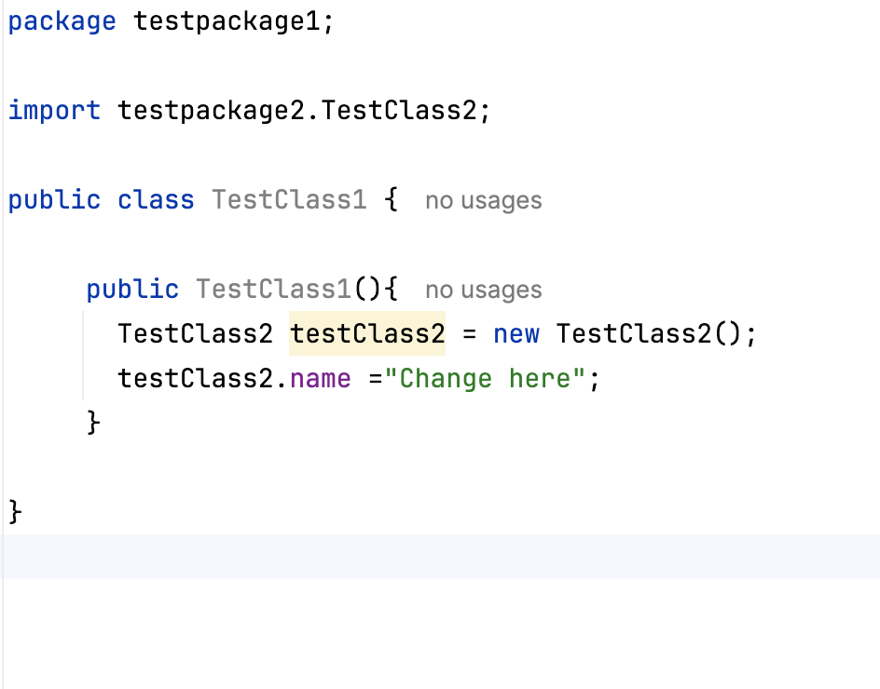
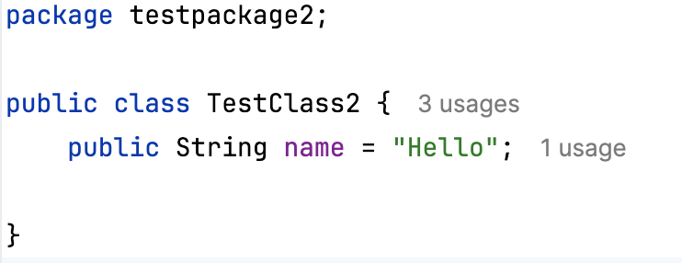
2. Private contd…
Top level classes or interfaces cannot be declared as private because data members or methods declared using “private” is only accessible within the enclosing class.
3. Public:
Specified using “public” keyword.
Has the widest scope. Classes, methods or data that are declared public are accessible from everywhere in the program.
There is no restriction on the scope of public data members.

Slide 6
Access Modifiers Contd..
4. Protected:
Specified using the keyword protected.
The methods or data members declared as protected are accessible only within the same package or subclasses in different packages

Slide 7
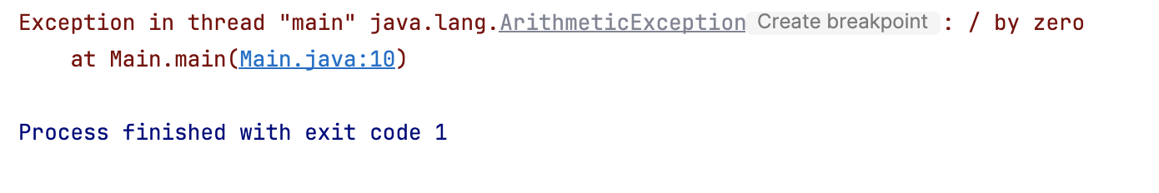
Exception Handling
Exception occurs when a program does not contain any syntax errors but asks the computer to do something that the computer is unable to reliably do.
The Exception Handling in Java is one of the powerful mechanism to handle the runtime errors so that the normal flow of the application can be maintained.
In Java, an exception is an event that disrupts the normal flow of the program.
It is an object which is thrown at runtime.
public class Main {
public static void main(String[]
args) {
System.out.println(1 / 0);
}}
The core advantage of exception handling is to maintain the normal flow of the application

Slide 8
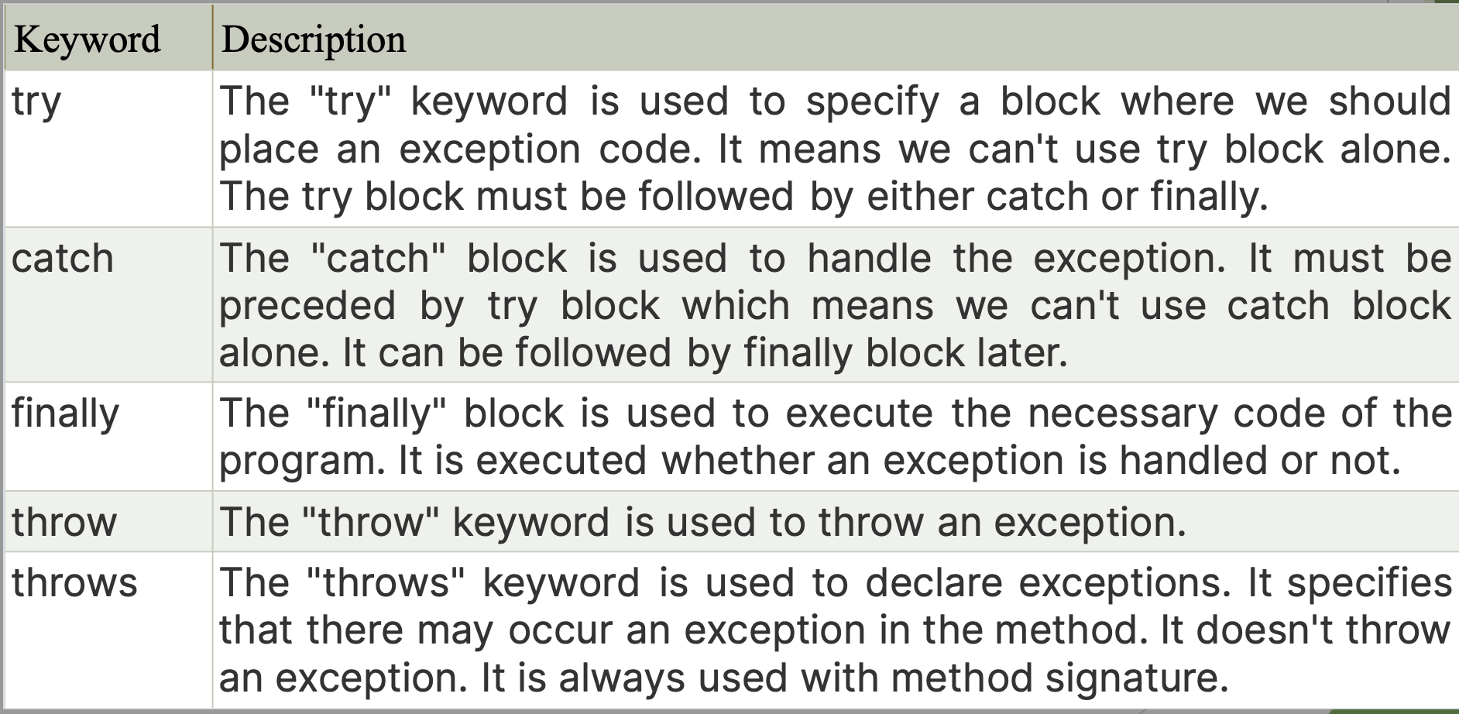
Exception Handling (contd…)

Slide 9
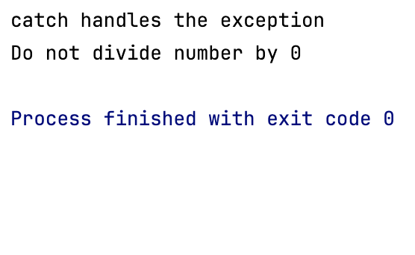
Exception Handling Contd..
public class Main {
public static void main(String[] args) {
try {
System.out.println(1 / 0);
}catch (ArithmeticException arithmeticException){
System.out.println("catch handles the exception");
}finally {
System.out.println("Do not divide number by 0");
}
}
}

Slide 10
Collections
The Collection in Java is a framework that provides an architecture to store and manipulate the group of objects
Java Collections can achieve all the operations that you perform on a data such as searching, sorting, insertion, manipulation, and deletion.
Java Collection means a single unit of objects.
Java Collection framework provides many interfaces (Set, List, Queue, Deque) and classes (ArrayList, Vector, LinkedList, PriorityQueue, HashSet, LinkedHashSet, TreeSet).

Slide 11
What is a framework in Java?
It provides readymade architecture.
It represents a set of classes and interfaces.
It is optional.

Slide 12
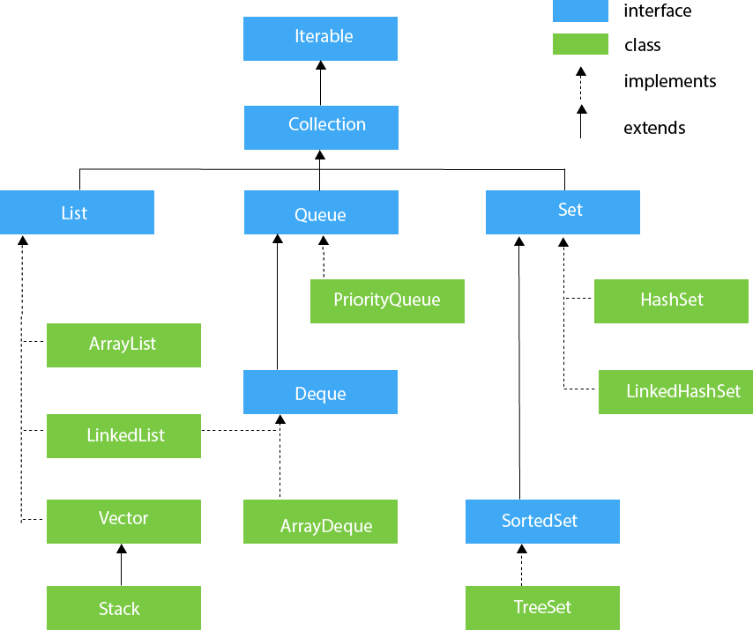
Hierarchy of Collection Framework

Slide 13
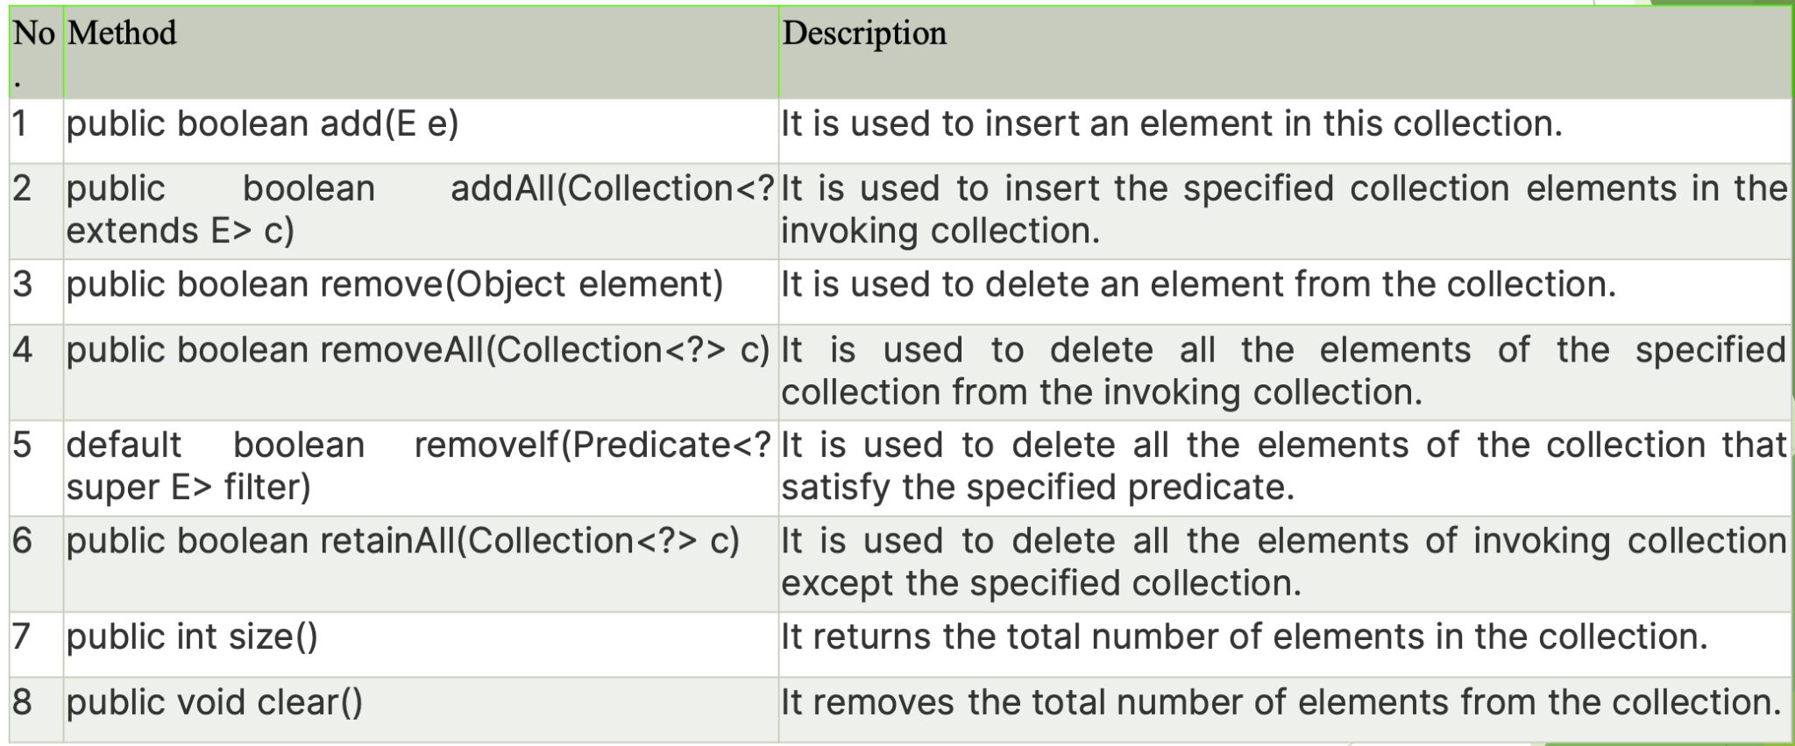
Methods of Collection Interface

Slide 14
Object Oriented Principles

Slide 15
Review of Object Oriented Principles
OOP is a programming paradigm, where entities, which can represent real-world objects, such as cars or animals are represented using attributes(properties) and behaviors(actions or functions).
OO Principles are the fundamental concepts that guide the design and implementation of object-oriented systems.
These principles help in creating modular, maintainable and reusable code.

Slide 16
The main object oriented principles are:
Objects
In java, everything is encapsulated within classes and objects. Any object, that comes from that respective class, are essentially reusable software components.
There are data objects, time objects, audio objects, video objects and so on.
Almost any noun can be reasonably represented as a software object in terms of attributes and behaviours.
For example: A car has a brand and a model and it can go from one place to another.
Classes and methods
Classes define the blueprint for creating objects, which are instances of classes.
In Java, class is a unit to house the set of methods and attributes.
The method contains the program statements that actually performs its tasks.
For example, a bank account may contain one method to deposit money to an account and another method to withdraw money and a third method to inquire what the account’s current balance is.
A class is instatianted and an object is created. The object,in turn calls the methods.
Classes are reusable components.

Slide 17
3. Encapsulation:
Classes( and their objects) encapsulate i.e encase their attributes and methods.
A class’s (amd its objects) attributes and methods are closely related.
Objects may communicate with one another, but they’re normally not allowed to know how other objects are implemented - implementation details are hidden within the objects themselves.
4. Inheritance:
A new class objects can be created conveniently by inheritance - the new class(called the subclass) starts with the characteristics of an existing class(called the superclass) possibly customizing them and adding unique characteristics of its own.
This promotes code reuse and facilitates hierarchical classification of objects.
5. Polymorphism:
Polymorphism is a concept by which we can perform a single action in different ways.
Polymorphism in Java can be performed through method overriding and method overloading.
If a class has multiple methods having same name but different parameters, it is method overloading.
If a subclass has same method as parent, it is called method overriding.

Slide 18
Method Overloading
public class Student {
private String name;
private int rollNumber;
public Student() {
}
public void setStudentAtrributes(String name) {
this.name = name;
}
public void setStudentAttributes(String name, int rollNumber){
this.name = name;
this.rollNumber = rollNumber;
}
}
public class Main {
public static void main(String[] args) {
//Student student = new Student();
Student student = new Student();
student.setStudentAtrributes("Ram Poudel");
student.setStudentAttributes("Ram Paudel",1);
}
}
Method Overriding
public class AnimalPolymorphismEx {
public void greeting() {
System.out.println("The animal greets you.");
}
}
public class DogPolyMorphismExample extends AnimalPolymorphismEx {
public void greeting() {
System.out.println("The dog barks.");
}
}
public class PolymorphismExample {
public static void main(String[] args) {
AnimalPolymorphismEx animalPolymorphismEx1 = new AnimalPolymorphismEx(); // Animal object
animalPolymorphismEx1.greeting(); // prints "The animal greets
AnimalPolymorphismEx dog = new DogPolyMorphismExample(); // Dog object
dog.greeting(); // prints "The dog barks
}
}

